Slide 1
Amazon Sales Data Analysis

Slide 2
Objective
Sales management has gained importance to meet increasing competition and the need for improved methods of distribution to reduce cost and to increase profits. Sales management today is the most important function in a commercial and business enterprise.

Slide 3
Benefits
Help out to make better business decisions.
Help analyze customer trends and satisfaction, which can lead to new and better products and services.
Gives better insight of customer base.
Helps in easy flow for managing resources.

Slide 4
Problem Statement
Extract-Transform-Load Amazon Sales Data dataset and find Sales-trend -> month-wise, year-wise, yearly-month-wise.
Find key metrics and factors and show the meaningful relationships between attributes.

Slide 5
Quick Insights for 2010 – 2017 Amazon Sales
Total Profit – 44,168,198
Total Cost – 93,180,570
Total Revenue – 137,348,768
Units Sold – 512,871

Slide 6
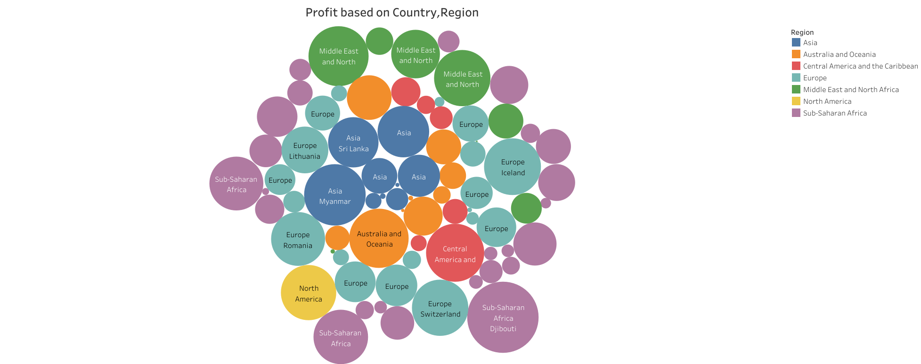
Profit with respect to Country, Region

Slide 7
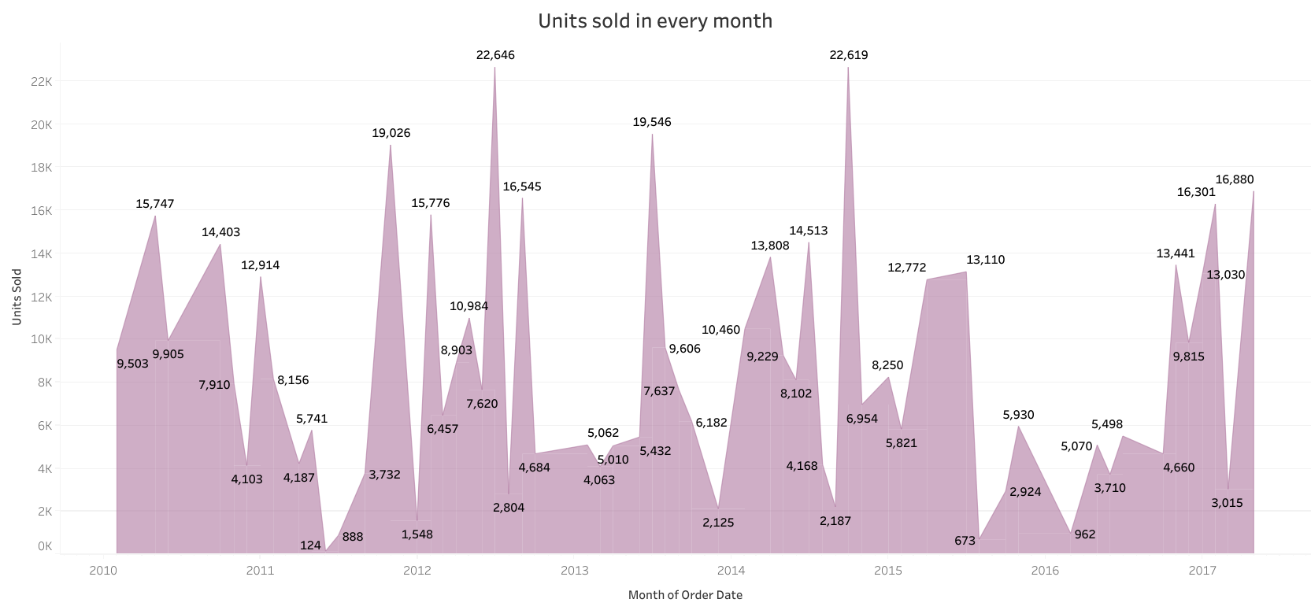
Units sold in Every Month from Year 2010 to 2017

Slide 8
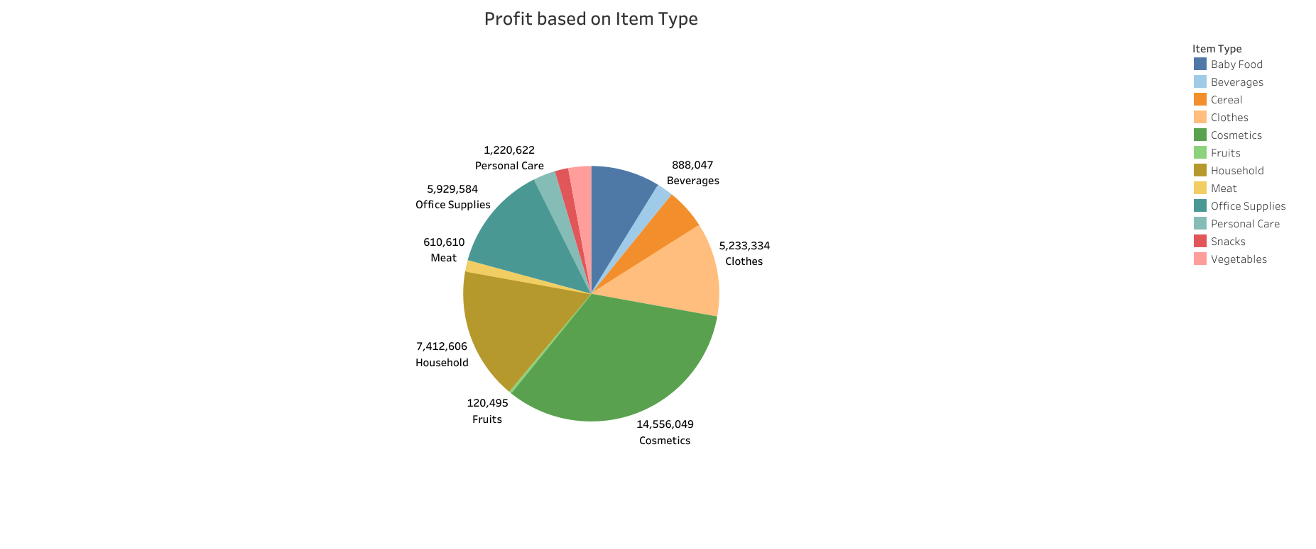
Profit with respect to Item Type

Slide 9
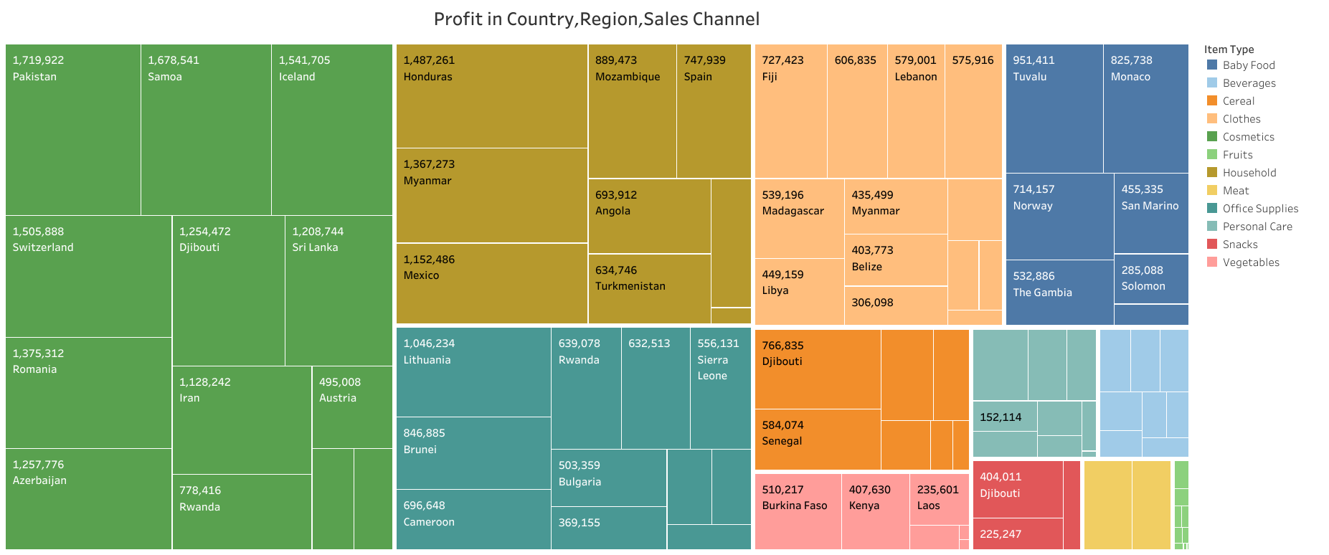
Profit for Country, Region, Sales Channel

Slide 10
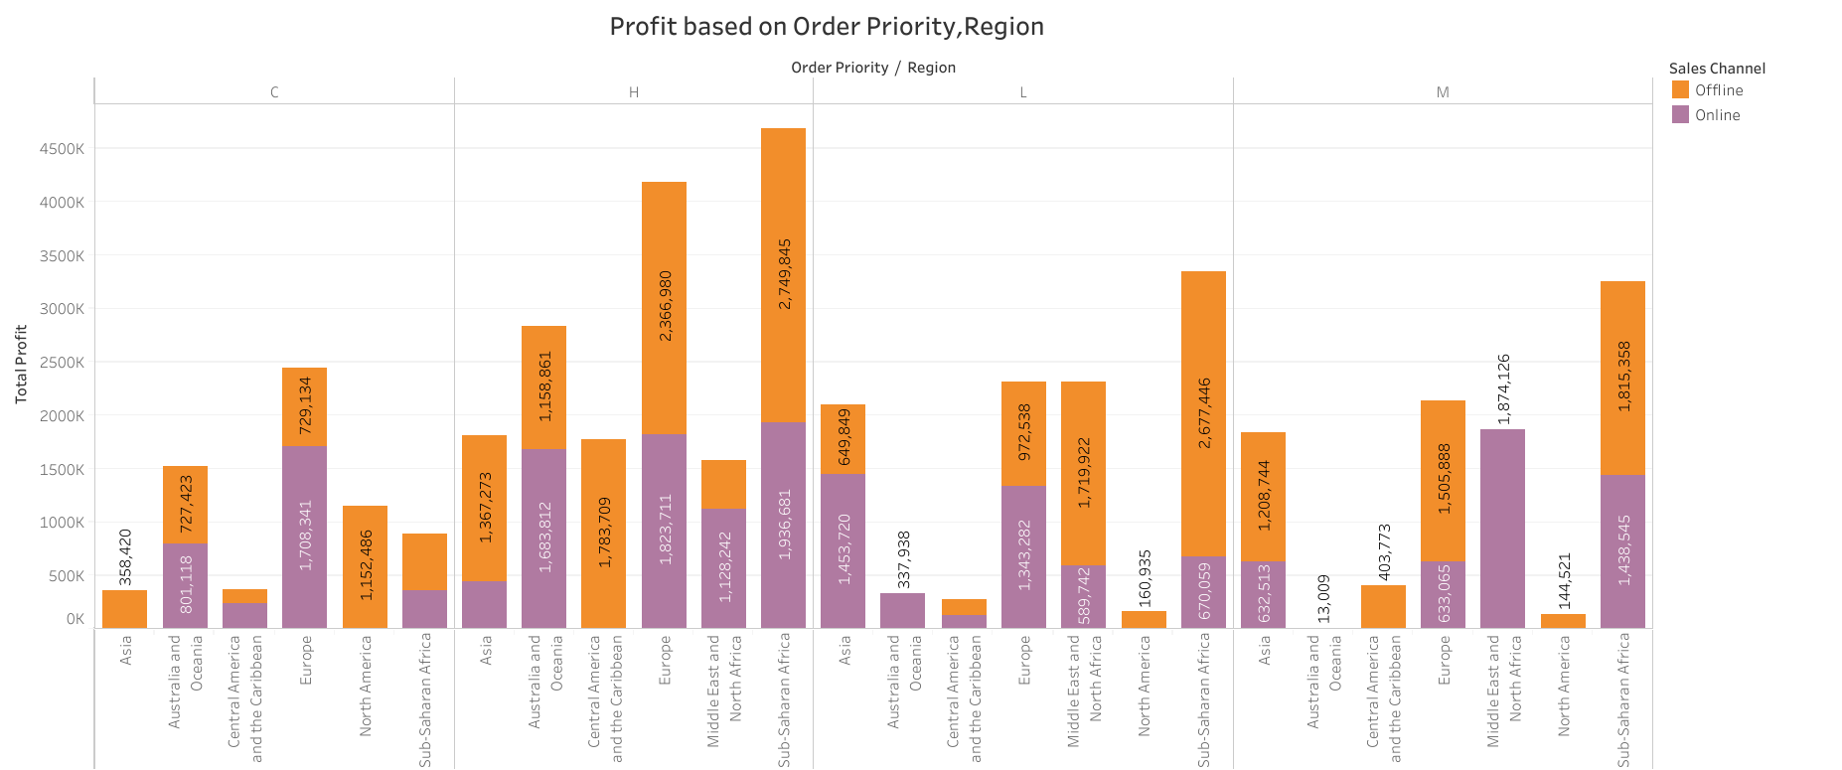
Profit for Order Priority, Region

Slide 11
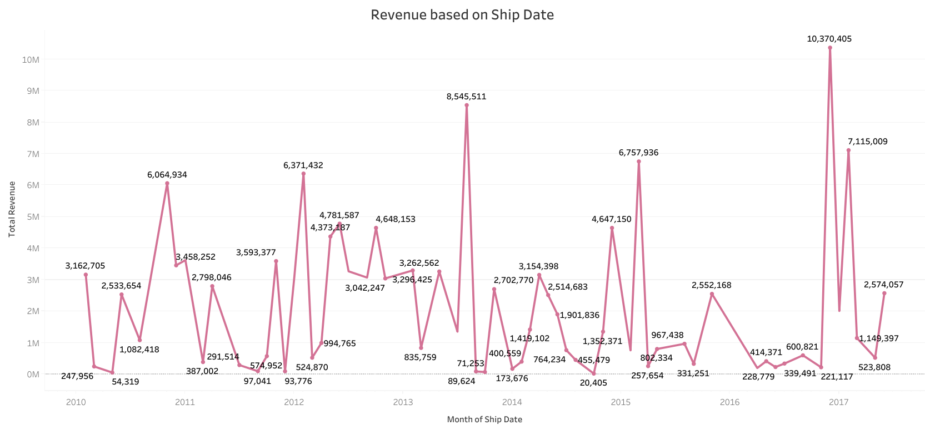
Revenue for Ship Date

Slide 12
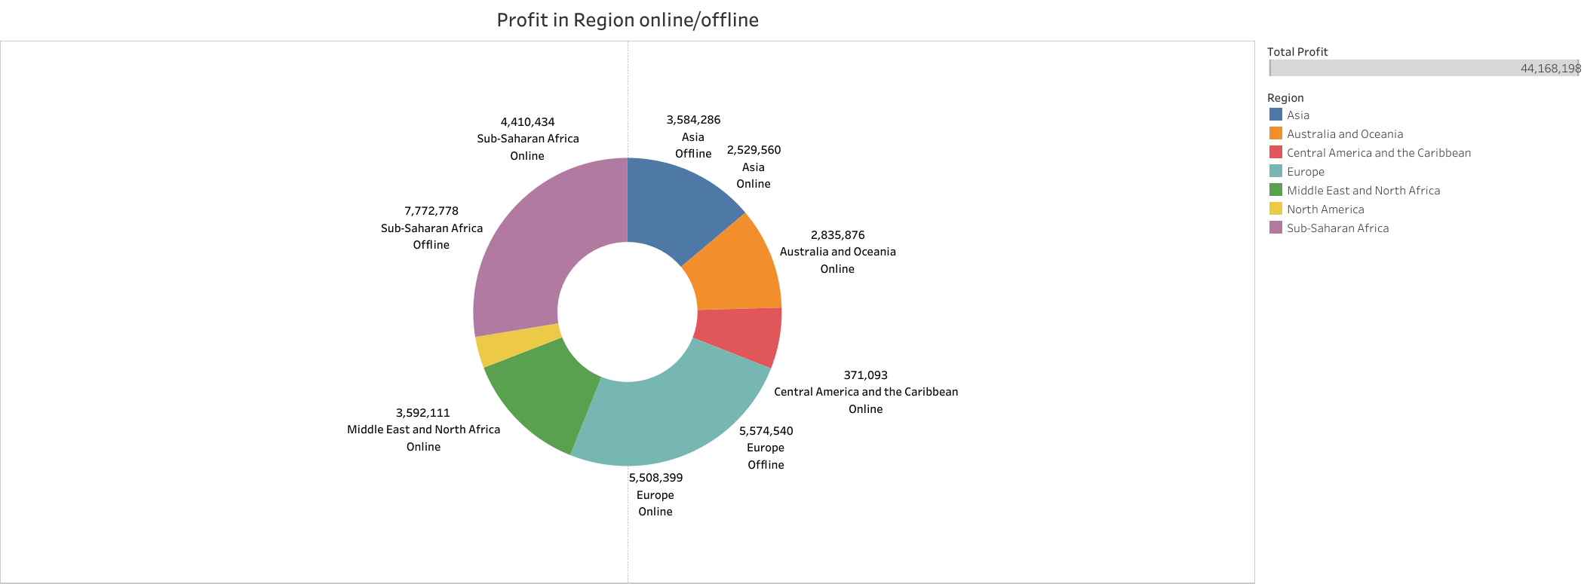
Profit for Region in Online/Offline

Slide 13
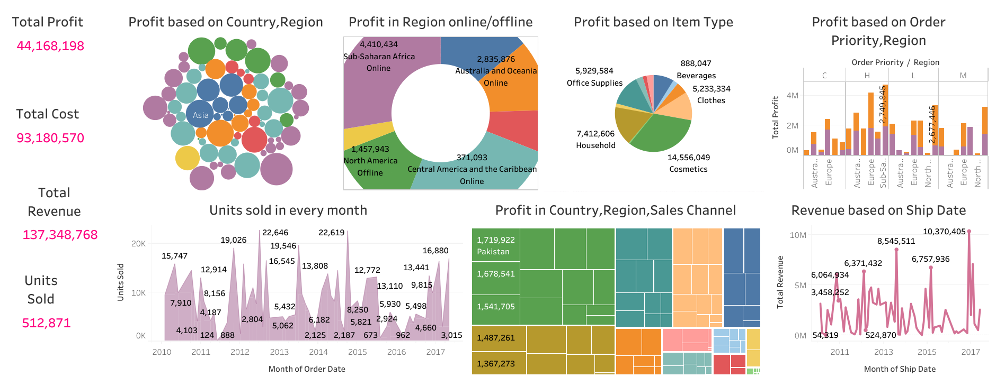
Amazon Sales Data Interactive Dashboard

Slide 14
Conclusion
The Profit is high in Djibouti Country with region Sub-Saharan Africa and the Profit is low in New-Zealand Country with region Australia and Oceania.
Units Sold is more in July month of year 2012 and Units Sold is less in June month of year 2011.
Profit and Revenue is high for the item type Cosmetics and low for the item type Meat.
Revenue is more in the ship month of December,2016 and less in the ship month of October,2014.
Profit is high for Sub-Saharan Africa region in Offline Sales Channel with Order Priority ‘H’ and low for Australia and Oceania region in online Sales Channel with Order Priority ‘M’.

Slide 15
Thank You

